Slide 2
Machine Learning Workshop Alexander Slotte - @alexslotte
Material: bit.ly/2Pc1HgC
Dive in to Getting started

Slide 3
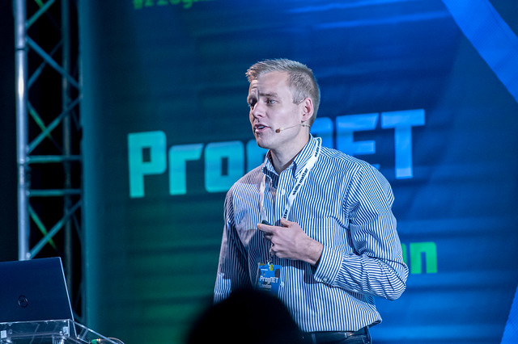
Alexander is a Lead Consultant and .NET Xpert at Excella, based out of Washington DC. He is an international speaker and have spoken at conferences such as ProgNET in London, .NET Jetbrains Global Online Day, Beer City Code, Music City Tech, Code PaLOUsa, Code On The Beach and Philly.NET. He's the organizer of the .NET DC User Group and a member of the .NET Foundation. He is passionate about .NET and cloud architecture, and constantly attempts to push his knowledge on data science and machine learning. When not coding, you'll find him out running or enjoying a good IPA! Say hi on Twitter @alexslotte!
Alexander Slotte
@alexslotte

Slide 4
Excella is an Agile technology firm and transformative partner to Washington, DC’s leading organizations. Since 2002, federal agencies, prominent brands and trailblazing non-profits have turned to Excella to transform bold ideas into elegant technology solutions. We believe technology exists to solve challenges and evolve thinking – we help organizations harness this power to make real progress. Learn more at www.excella.com.

Slide 5
What are we going to do?
Part 1
Introduction to Machine Learning/ML.NET
Train our model in ML.NET
Train our model using AutoML
Part 2
Introduction to Stream Processing
Set up our Azure Stream Analytics Job
Part 3
Introduction to MLOps
Set up a CI/CD pipeline for model
Fraud Detection

Slide 6
What are we going to do?
Part 4
Introduction to ML.NET + Jupyter
Train our classifier in C# in Jupyter
Part 5
Introduction to Azure ML Service
Train our model in Azure ML Service
Part 6
Use an ONNX model
Fraud Detection

Slide 7
General Information
Workshop material: bit.ly/2Pc1HgC
Please take breaks as needed
Data – USB/Online
Please start with - Getting started

Slide 8
What do you identify youself as?

Slide 9
How familiar are you with Machine Learning?

Slide 10
How familiar are you with Stream Procesing?

Slide 11
How familiar are you with Azure?

Slide 12
Part 1
Machine Learning and ML.NET

Slide 13
Agenda
Part 1
Introduction to Machine Learning/ML.NET
Train our model in ML.NET
Train our model using AutoML

Slide 14
What is Machine Learning?
Notes:
So what is Machine Learning?
Machine Learning is all around you today and you can see it in everything from a simple applications such as a spam filter in your inbox, to your Google Home or Alexa. It is commonly used in medical diagnostics, self-driving cars, stock market analysis and various recommendation engies, e.g. Netflix or Spotify.
Facebook and Goggle are by fare the market leaders in AI and Machine Learning, although companies such as Microsoft is quickly catching up.

Slide 15
Programming the unprogrammable

Slide 16


Slide 17
“Field of study that gives computers the ability to learn without being explicitly programmed.”
Arthur Samuel (1959)
Notes:
Defining what Machine Learning is, is not a trivial task. There are, and have been many definitions of what machine learning is over the years.
A prominent figure in the Machine Learning space in the 1950's Arthur Samuel, defined machine learning as the field of study that gives computers the ability to learn without being explicitly coded.
What machine learning is really all about is teaching a mathematical model to make decisions on real-world data, in such a way that it can make accurate predictions on incoming new data that the model was not trained with.
We can for example train a model on a large number of animal pictures, in the hopes that our trained model will from now on be able to detect if a specific animal is a picture or not.
Artifical Intelligence expert argue that machine learning is the best way forward towards human-like AI

Slide 18
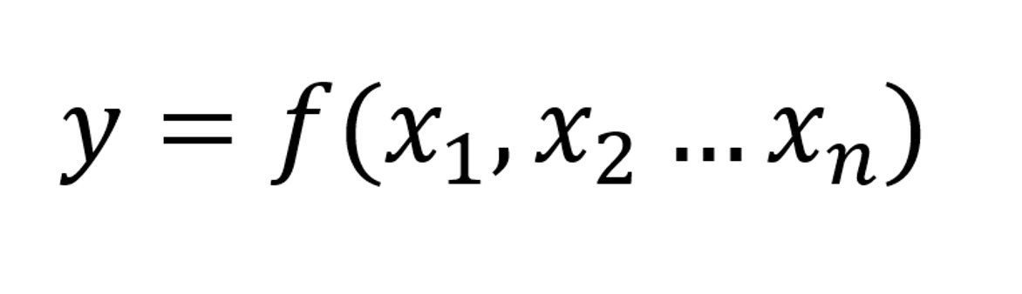

Slide 19
Features
Label

Slide 20
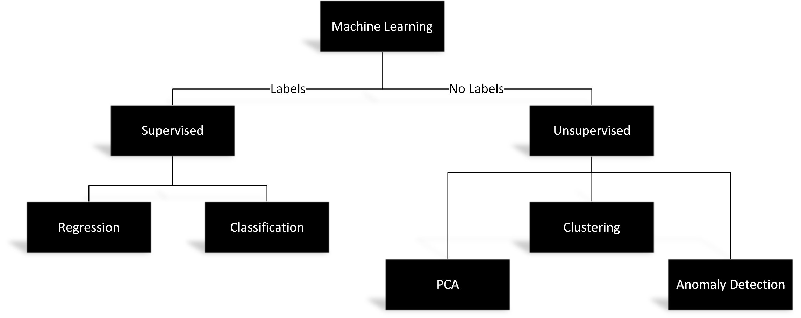
Supervised vs Unsupervised
Notes:
There are different types of machine learning. The two most commons ones that you may have heard of, is supervised and unsupervised machine learning, although concepts such as reinforcement learning also exist.
In supervised learning, we are doing our best to teach the computer to do something specific.
At our disposal, we not only have the data necessary to train our model, but we also have the known answer, often referred to as labels.
A good example of this may for example be creating a model that classifies e-mails as important or not.
In order to create this model, we would need to have a large set of e-mails, already labeled as important or not important.
We would then be able to use a supervised machine learning task, such as classification, to train our model on, and creating a model that accurately labels e-mails.
Unsupervised learning is the case where the correct answer is not known, and the computer teaches itself. Clustering, Principal Component Analysis and Anomaly Detection are good examples of unsupervised learning.

Slide 21
Notes:
Layers of fully or semi connected neurons
Input and output layer, input taking variables, e.g. pixels in an image while the output is what we are trying to predict
The network learns through a process called backpropagation, in which it adjust it self during learning to give a more and more accurate prediction

Slide 22
Notes:
A concrete example is fraud detection

Slide 23
Neural Networks | Building Blocks
Neuron | An abstraction of linear algebra
Weights/Biases | Stores the knowledge
Loss Function | Feedback mechanism
Optimizers | How the network learns
Activators | Introduces a non-linear behavior
Epoch | One pass through the network

Slide 24
Anatomy of a Neuron

Slide 25


Notes:
If we zoom out a bit, we can put all the bits and pieces together, and look at a concrete example for image classification
We pass through an image through the layers and each layer will extract more and more important features from the image. Each neuron in each layer goes through an activation function, which introduces that non-linear behavior. A couple of common ones are Relu or a Sigmoid function we see here.
The network then makes a prediction, e.g. dog in this case. We will then use a loss function to calculate, how far away from the true value was the network. If the image actually was a cat then we are far off. We’ll then apply an optimizer, usually a variant of Stochastic gradient decent to adjust the networks internal weights and biases in each layer. This is how the system learns. And the process is then repeate.

Slide 26
Types of Networks
Notes:
So what is Machine Learning?
Machine Learning is all around you today and you can see it in everything from a simple applications such as a spam filter in your inbox, to your Google Home or Alexa. It is commonly used in medical diagnostics, self-driving cars, stock market analysis and various recommendation engies, e.g. Netflix or Spotify.
Facebook and Goggle are by fare the market leaders in AI and Machine Learning, although companies such as Microsoft is quickly catching up.

Slide 27

Convolutional Neural Network

Slide 28
Multi-Layer Perceptron

Slide 29
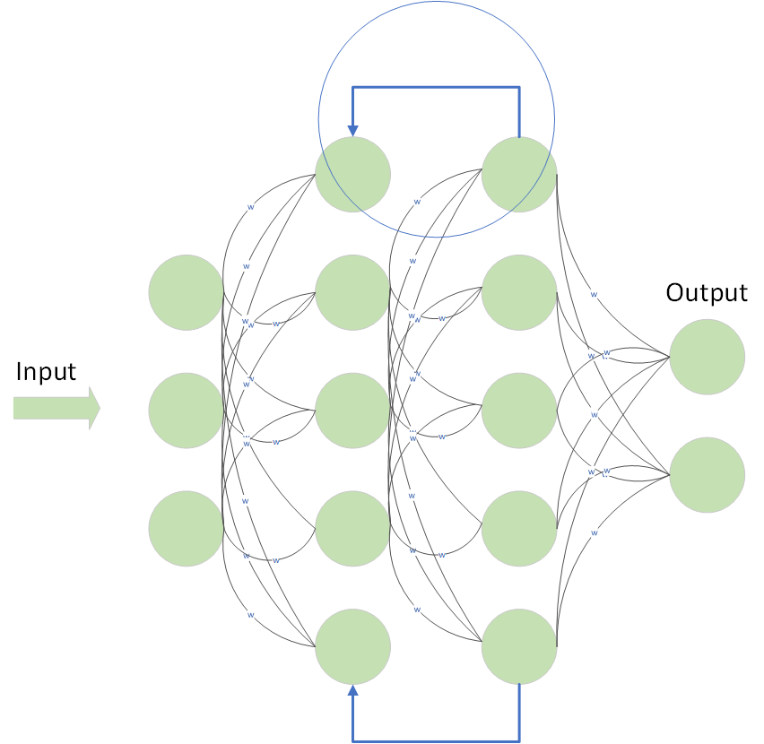
Recurrent Neural Network

Slide 30
Transfer Learning
Notes:
So what is Machine Learning?
Machine Learning is all around you today and you can see it in everything from a simple applications such as a spam filter in your inbox, to your Google Home or Alexa. It is commonly used in medical diagnostics, self-driving cars, stock market analysis and various recommendation engies, e.g. Netflix or Spotify.
Facebook and Goggle are by fare the market leaders in AI and Machine Learning, although companies such as Microsoft is quickly catching up.

Slide 31
Leverage state-of-the-art architectures
Re-train a DNN on a similar problem
Why is Transfer Learning important?
Training a DNN can take hours to weeks
Limited access to large amount of data

Slide 32

How to build your own model
The Machine Learning Workflow
Notes:
Alright, so we have now covered most of the basics of machine learning, but what is the actual process for building your own model, in a framework such as ML.NET or even Scikit learn or another Python based library?
How can you get started today?

Slide 33

Identify your problem
Notes:
The first step is to identify your problem. What are we trying to solve?
Are we doing text analysis such as sentiment analysis or text classification? Are we trying to decide how customers in your client base are similar and in what way? Are trying to create a model that can determine what breed a dog is just based on an image?
Depending on your problem, there will be different requirements on the data you'll need to collect as well as which machine learning task or training algorithm you may need to use.

Slide 34

Gather your data
Notes:
Once you've determined your problem, the next step will be to gather you data. This is in my opinion the most important step of them all. The accuracy of your model greatly depends on the provided data.
If the model does not have enough data to train on, it will not be able to make good enough predictions.
Similarly,if the data is biased or sqwed, the predicted outcome will also be biased.
Lets say that your for example are training a model to determine the likelihood of a person committing a crime but your data only contain individuals convicted of a crime from a specific demographic group. Doing so will create a biased model, as the model has been trained that this specific group is more likely to commit a crime although the data may not be representative of the larger picture.
In this step we want to make sure to capture as much data and make our dataset as wide as possible to make sure our model accurately can account for any known variance.

Slide 35

Split your data
Notes:
Once you've collected your data, we want to divide it.
A common practice when working with especially supervised learning, is to split your dataset in to two buckets, usually at a ratio of 70 and 30%.
70% of your data will be used to train your model, while the remaining 30%, which the model is not aware of, will be used to evaluate the model to determine how accurate it is in predicting a gven outcome.
We will see how this is done in practice once we start coding with ML.NET in just a little bit

Slide 36

Transform your data
Notes:
Machine Learning algorithms are very very picky. They do not like dirty data, and they only work on float vectors. Thus we are tasked with the job of transforming our data before we can have our machine learning algorithms work on it. This is a very important step, as this is where we ensure data quality going in.
Common things that we normally would like to do here is to replace any missing values in a data column, or normalize variables to a value between 0 and 1. We also want to make sure to transform non-float values to floats. We can do this with for example a technique called Categorical OneHotEncoding. OneHotEncoding takes a non-float value variable, say for example the make of a car in a dataset, and creates additional binary columns, say IsMazda (with a value of 0 or 1), IsAudi (with a value of 0 or 1) and so forth.
This offers a huge performance boost for the machine learning algorithms and transforms the data to a language that the algorithm can understand and work on.

Slide 37
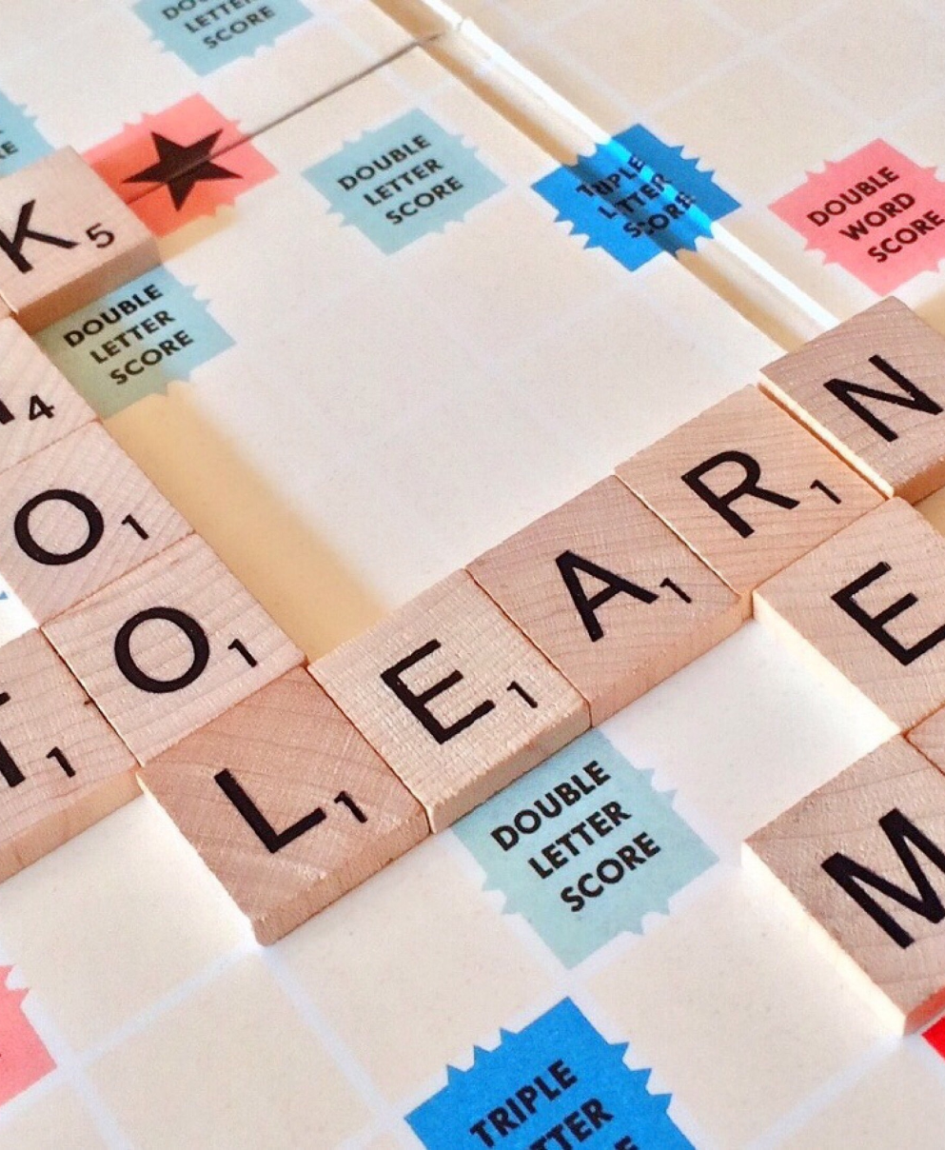
Train your model
Notes:
Once you have your data in a neat and clean format, it's time to train your model.
Training your model basically means choosing which algorithm you want to use when attempting to fit your data. There are tons of alternatives out there, some are better than others in different scenarios, you may for example want to use an average perceptron for binary classification cases, while other are available for clustering or regression. At first, it can seem very daunting to know what algorithm to chose here, and I would just like to make a couple of quick notes on that.
Firstly, this process involves a lot of trial and error – once you have trained your model, you will be able to measure how accurate it is, and if need be, you can just go back and chose another algorithm.
Secondly, the Microsoft documentation is very useful to help you navigate which algorithm to chose in which scenario
Third and lastly, techniques such as AutoML which ML.NET support, completely elevates this process as it will automatically discover which learning algorithm best fits your dataset.

Slide 38

Evaluate your model
Notes:
- We need to measure the accuracy of our model so we know if we need to improve it
- We use our test data set to do this

Slide 39
Evaluate your model
Accuracy
Mean-Squared Error
Precision
Recall
Confusion Matrix
Notes:
- We need to measure the accuracy of our model so we know if we need to improve it
- We use our test data set to do this
- Precision and Recall

Slide 40

Deploy your model
Notes:
Once you're happy with the accuracy of your model, it's time to put it to work.
This is one of the beauties with ML.NET, as it allows us in minutes to deploy out model as part of an ASP.NET Core application, an Azure Function or integrate it in other ways in to your existing .NET application.
Once the model is in operation, it is important to monitor the performance of the model and iteratively evaluate and improve it with more data as needed.
A good example of this would for example monitor which e-mails a user manually labels as spam, so that your model is able to detect this in the future.

Slide 41
ML.NET
Notes:
So if we apply this workflow to ML.NET, how would it look?

Slide 42

Machine Learning for .NET Developers
Open-source
Cross-platform
Custom models in C#
AutoML
Supports Transfer Learning
Native TensorFlow support

Slide 43


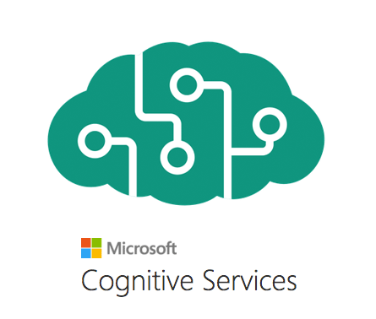


The AI/ML Landscape
Easier/Less Control
Harder/More Control
Notes:
The Machine Learning and AI landscape is very competitive. There is a flora of available options out there, depending on your needs and ML.NET is just one of many options.
Some of you may be familiar with Azure Machine Learning Studio or Azure Machine Learning Service, you may find this product to the left in this slide together with Azure Cognitive Services. These technologies are in general easier to get started with, but offers you less control as in particular Azure Cognitive Services, which pre-dominantly offers pre-trained models that you pay to utilize.
This may be great for many scenarios, but if you ever want to build a custom model based on your own data, those services will not be enough.
This is where products such as ML.NET comes in to play, which allows you to build completely custom machine learning models.
Although slightly more difficult to master, they provide you with the control needed in many real-world scenarios.
You may also find other products in this space such as Scikit learn and TensorFlow, which is Google's flagship product for deep learning.
We will touch upon this later in this talk, but you can actually use a deep learning model from TensorFlow with ML.NET.
This is made possible by an open-standard called ONNX, which is backed by Google, Microsoft and Facebook.

Slide 44
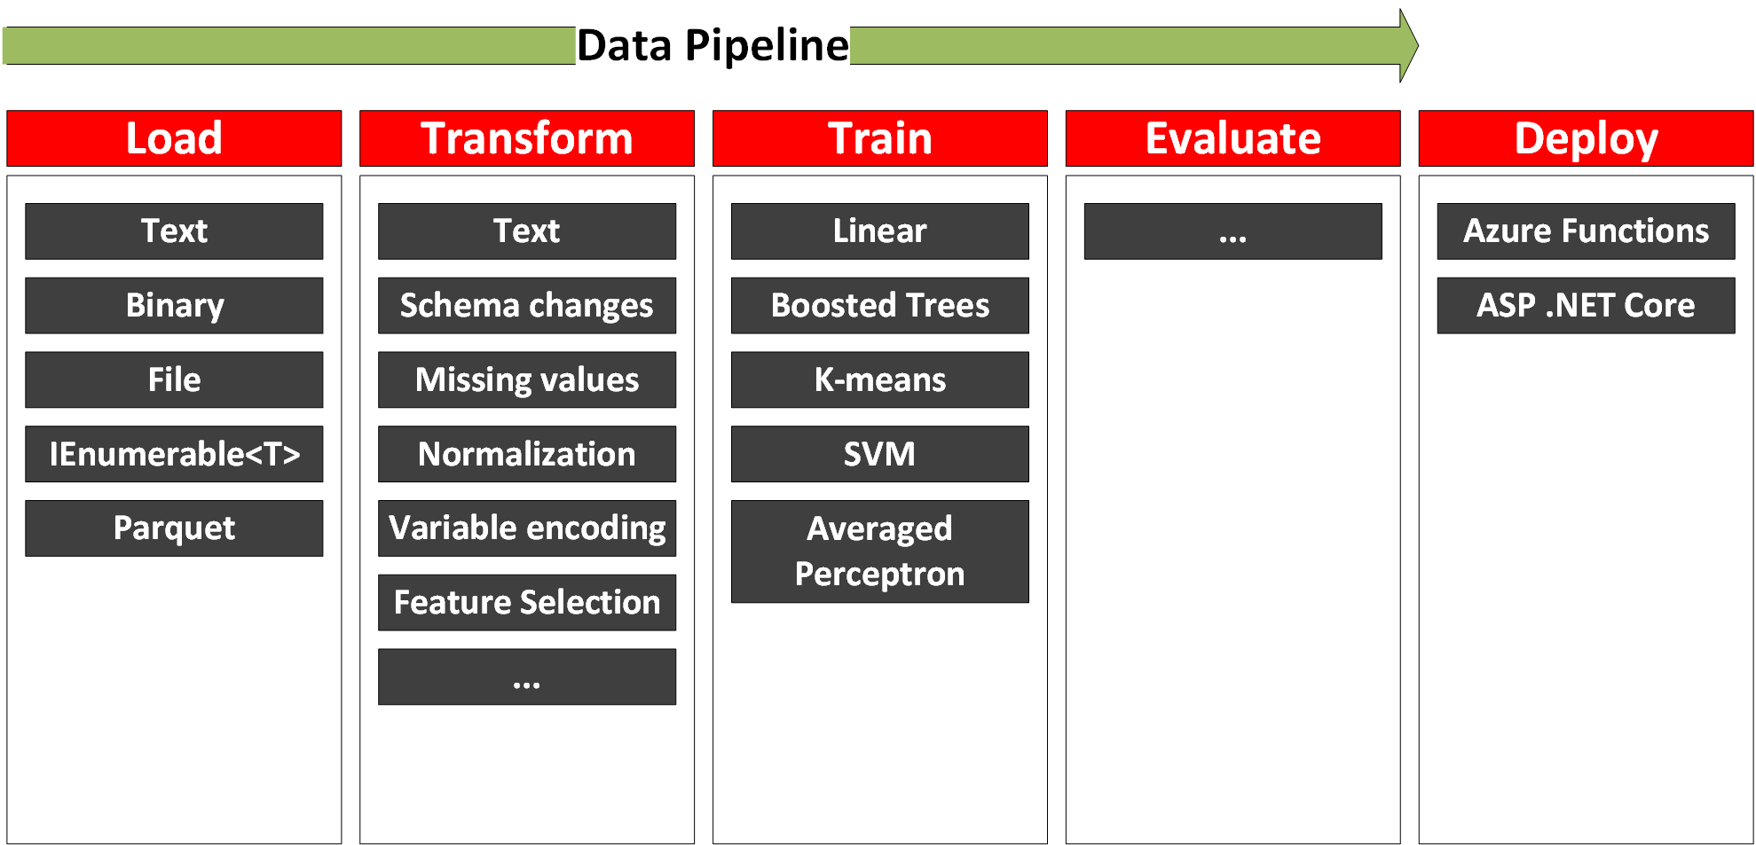
Machine Learning Workflow (ML.NET)
Notes:
So if we take the Machine Learning context and look at how each part of it can be translated to the features and functionality of ML.NET, what do we get.
Firstly, given that we have identified our problem and gathered our data, we can load it using a number of different ways...
We can then transform it...
And finally select a trainer and evaluate it.
The functionality to do all of these operations resides on something called the MLContext which is a ML.NET construct. The object, holds all of the namespaces or catalogus of features needed to train your model.
Using the MLContext we can create data processing and training pipelines, on which we can append transformers and trainers of our chosing.
The final model is then saved as a .zip file, which we can deploy to whereever we like, e.g. blob storage or include as part of an application.

Slide 45
Tutorial
Train a model in ML.NET

Slide 46
Break

Slide 47
Part 2
Real-Time Stream Processing
Azure Stream Analytics

Slide 48
Agenda
Part 2
Introduction to Stream Processing
Introduction to Azure Stream Analytics
Set up our Azure Stream Analytics job
Notes:
So what are we going to talk about today?
We are going to get started with looking at ML.NET and it's history and then fairly quickly transition in to uncovering the concepts behind the buzzwords Machine Learning and Deep Learning.
Although ML.NET makes Machine Learning a lot easier to perform, it is important to know some of the basics to follow along in discussions as well as when building out your code base.
Once we have a good understanding of the concepts, we will take a step back and look at the overall machine learning workflow that we can use to train our own model.
My hope is that we will spend about half of this talk on doing some live coding, where we will be training our own model using the framework.

Slide 49
What is Real-Time Stream Processing?

Slide 50





Notes:
Bank fraud
Washington DC – giving a fine if you speed through an intersection
Tolls or real time monitoring of traffic patterns
Predicitve maintenance
Industrial factories and monitoring of pressure valves or processers (one would normally include IoT Edge in this scenario
Autonomous cars, start, stop and turn based on live feedsq a

Slide 51
What is a stream?
Continuous
Stems from multiple sources
Small (Kb)
Timestamp/value
Notes:
Three pillars
What is a stream really made up off?

Slide 52
Batch vs Stream Processing
 | Batch Processing | Stream Processing
Data Volume | Large volumes | Small volumes
Query Processing | Entire dataset | Subset of data
Query Latency | Minutes to hours | Milliseconds to seconds
Data Insight | Processed hourly to daily | Near real-time insights

Slide 53
Technologies

Slide 54
Streaming Technologies
 | Azure Stream Analytics | HDInsight with Spark Streaming | Apache Spark in Azure Databricks | HDInsight with Storm
Programmability | ASQL, JavaScript | Scala, Python, Java | Scala, Python, Java, R | Java, C#
Programming paradigm | Declarative | Declarative and Imperative | Declarative and I mperative | Imperative
Pricing model | Streaming units | Per cluster hour | Databricks units | Per cluster hour
*Azure Functions
*Azure WebJobs

Slide 55
Azure Stream Analytics

Slide 56
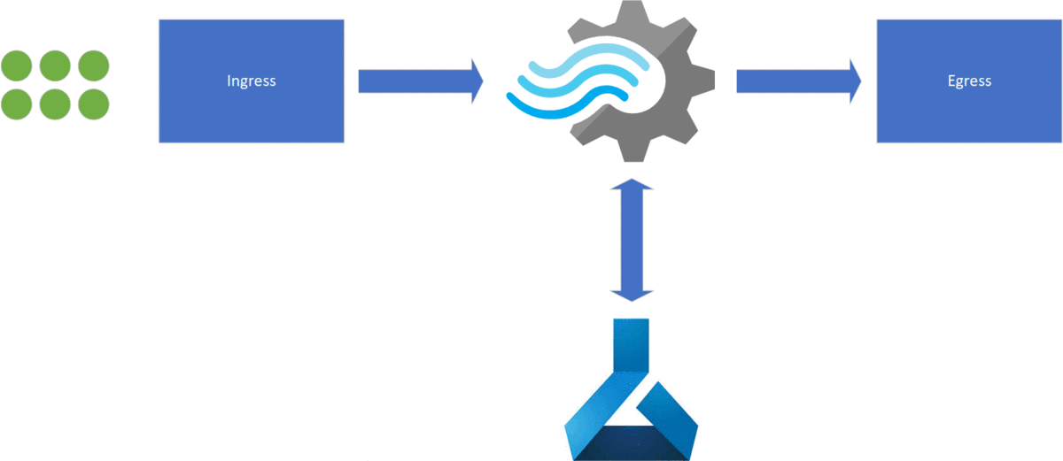
Azure Stream Analytics

Slide 57

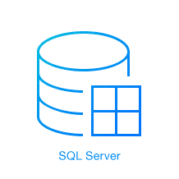


Ingress

Slide 58






Egress
Notes:
Microsoft Quiz
PBI
Azure Functions
Blob Storage
EventHub
SQL Server
Table storage
MessageBus
Data Lake

Slide 59
Temporal Windows
Notes:
- Every data we stream needs to have a timestamp associated with it
- We can either use the application timestamp or just use a system timestamp as it enters
- Windows basically creates a table which we can query
- Difference between time of arrival and application time (!)

Slide 60
Tumbling window
GROUP BY TumblingWindow(minute, 1)
Notes:
You can group your data in to temporal windows in order to perform the analysis on the moving data stream.
A tumbling window splits the analysis in non-overlapping equal size temporal windows
A tumbling window is very usefult to for example answer the question Tell m e the count of tweets for every 10 seconds internval

Slide 61
Hopping window
GROUP BY HoppingWindow(Duration(minute, 1), Hop(second, 5))
Notes:
Every 5 seconds tell me the count of tweets we have over the last 10 seconds
Smooths out the trends of the data
Windows overlap
An event can fall between two distinct windows

Slide 62
Sliding window
GROUP BY SlidingWindow(seconds, 10) HAVING COUNT(*) > 10
Notes:
- Give me the count of tweets for all topics which are tweeted more than 10 times in the last 10 seconds

Slide 63
Temporal SQL

Slide 64
Azure Stream Analytics - SQL
SELECT *
INTO output
FROM input
GROUP BY TumblingWindow(minute, 1)
Notes:
- This is the basic structure of Azure Stream Analytics SQL
Notice the following
1. We select into something, from something (egress and ingress)
2. We normally group by a temporal window for any aggregation functions
3. The events are normally in an object structure. We can access properties or arrays on the objects easily

Slide 65
Built-In Functions
Analytic LAG
ISFIRST
FIRST
ISLAST
LAST
ANOMOLYDETECTION
Array Functions
GETARRAYLENGTH
GETARRAYELEMENT
GETARRAYELEMENTS
Conversion CAST
GETTYPE
TRY_CAST
Geo Spatial
CREATELINESTRING
CREATEPOINT
CREATEPOLYGON
ST_DISTANCE
ST_OVERLAPS
ST_INTERSECT
ST_WITHIN

Slide 66
Performance and Scaling

Slide 67
Scaling and Pricing
CPU + Memory + Storage => Streaming units (SU)
$0.11 h per SU = $82/month
Max 192 SU per job
Query Performance

Slide 68
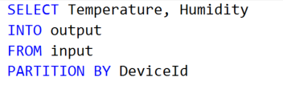
Performance
Use PARTITION BY to run in parallel
An EventHub has 2-32 partitions
Not all jobs are possible to run in parallel

Slide 69
Tutorial
Azure Stream Analytics with Machine Learning

Slide 70
Part 3
ML.NET + Azure DevOps

Slide 71
Agenda
Part 3
Introduction to MLOps
Set up a CI/CD pipeline for model
Notes:
So what are we going to talk about today?
We are going to get started with looking at ML.NET and it's history and then fairly quickly transition in to uncovering the concepts behind the buzzwords Machine Learning and Deep Learning.
Although ML.NET makes Machine Learning a lot easier to perform, it is important to know some of the basics to follow along in discussions as well as when building out your code base.
Once we have a good understanding of the concepts, we will take a step back and look at the overall machine learning workflow that we can use to train our own model.
My hope is that we will spend about half of this talk on doing some live coding, where we will be training our own model using the framework.

Slide 72
Machine Learning + DevOps = MLOps
Continuous Integration
Build
Train
Test
Continuous Deployments
Dimensions of Change
Code
Data
Model

Slide 73
“Continuous Delivery for Machine Learning (CD4ML) is a software engineering approach in which a cross-functional team produces machine learning applications based on code, data, and models in small and safe increments that can be reproduced and reliably released at any time, in short adaptation cycles.“, Martin Fowler, 2019

Slide 74
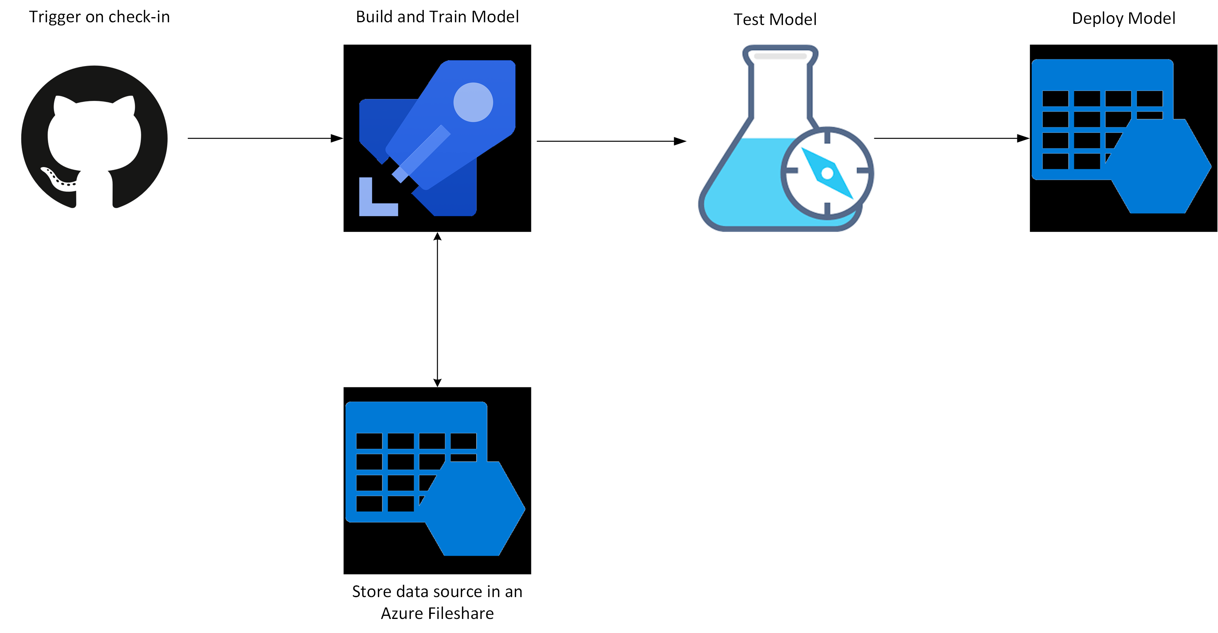

Slide 75
Tutorial
Set up our CI/CD pipeline in Azure DevOps

Slide 76
Part 4
Jupyter + ML.NET

Slide 77
Agenda
Part 4
Introduction to ML.NET + Jupyter
Train our classifier in C# in Jupyter
Notes:
So what are we going to talk about today?
We are going to get started with looking at ML.NET and it's history and then fairly quickly transition in to uncovering the concepts behind the buzzwords Machine Learning and Deep Learning.
Although ML.NET makes Machine Learning a lot easier to perform, it is important to know some of the basics to follow along in discussions as well as when building out your code base.
Once we have a good understanding of the concepts, we will take a step back and look at the overall machine learning workflow that we can use to train our own model.
My hope is that we will spend about half of this talk on doing some live coding, where we will be training our own model using the framework.

Slide 78
ML.NET + Jupyter
Currently in private preview
Runs on a C# kernel
DataFrame
Xplot.Plotly for plotting
Improves readability
Improves execution
Improves shareability

Slide 79
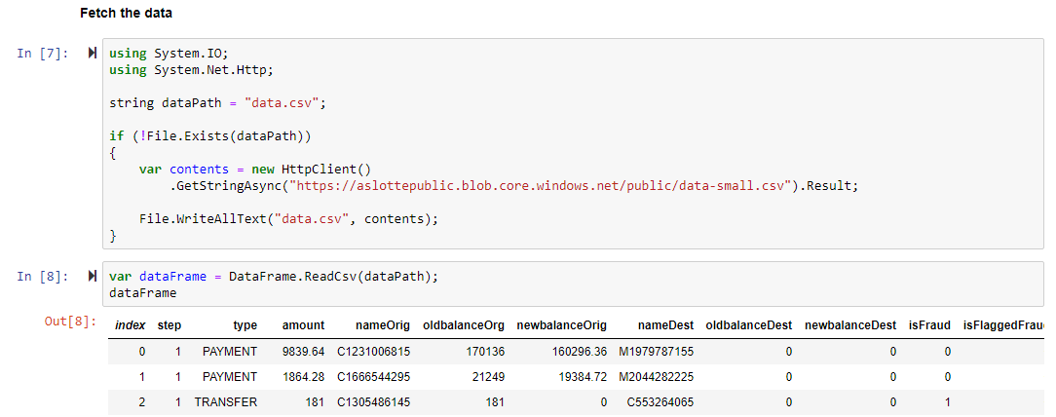

Slide 80
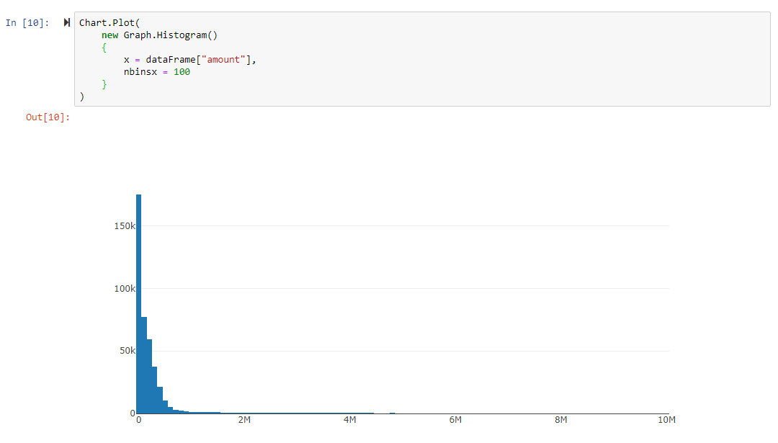

Slide 81
Tutorial
Train a model using
Jupyter + ML.NET

Slide 82
Part 5
Azure Machine Learning Service

Slide 83
Agenda
Part 5
Introduction to Azure ML Service
Train our model in Azure ML Service
Notes:
So what are we going to talk about today?
We are going to get started with looking at ML.NET and it's history and then fairly quickly transition in to uncovering the concepts behind the buzzwords Machine Learning and Deep Learning.
Although ML.NET makes Machine Learning a lot easier to perform, it is important to know some of the basics to follow along in discussions as well as when building out your code base.
Once we have a good understanding of the concepts, we will take a step back and look at the overall machine learning workflow that we can use to train our own model.
My hope is that we will spend about half of this talk on doing some live coding, where we will be training our own model using the framework.

Slide 84
Azure Machine Learning Service
Cloud service to train/manage/deploy ML models
Replaces Azure Machine Learning Studio
Various levels of complexity
Visual interface
AutoML
Jupyter Notebooks
MLOps

Slide 85
Jupyter Notebooks
Successor of IPython Notebook
Julia + Python + R = Jupyter
Cells and Kernels
Premier development environment for Data Science
Local or in the cloud

Slide 86
Open Neural Network Exchange (ONNX)
Backed by Microsoft, Google, Facebook
Transformation of models to an open format
A means to use Deep Learning models in ML.NET

Slide 87
Tutorial
Train a model using
Azure Machine Learning Service

Slide 88
Thank you!
Twitter:
@alexslotte
Material:
bit.ly/2Pc1HgC
Feedback greatly appreciated

